Slide 1

‘’Data-ball’’

Slide 2

Business Questions
Does the number of Goals affect the amount of the audience?
Does the amount of the audience affect the number of Goals?
What are the factors that affect the number of purchased tickets for the game?
What attractive destinations for hosting international competitions with the largest expected income from the audience?

Slide 3



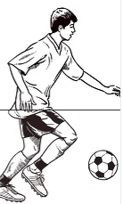

Business Targets
Identifying the largest market shares from the country level to the player level.
Identifying the demand for tickets among the home crowd.
Market value analysis for a player according to his performance.
Identification of audience arrival trends by periods in the season.

Slide 4
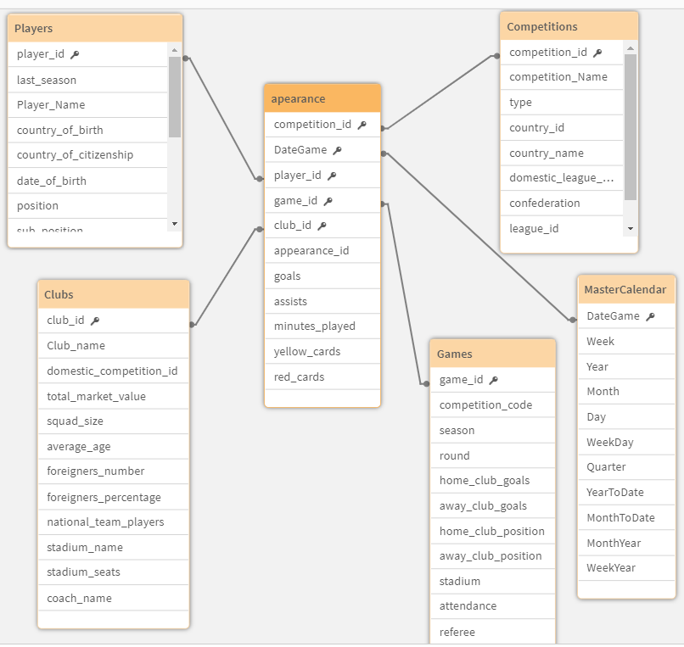
The “Star-Schema”

